Slide 1

INSTITUTE: UIE (AIT-CSE)
Computer Networks CST- 335
Introduction to UDP protocol.
Principles of Reliable Data Transfer
By : Dr.Monica Luthra(E9836)
DISCOVER . LEARN . EMPOWER

Slide 2

Course Objectives
CO Number | Title | Level
CO1 | To bring together several keys to Computer Network Design and Architecture. | Remember
CO2 | To recognize the key concepts of Internetworking. | Understand
CO3 | To prepare a sample Network via Simulation. | Understand

Slide 3
Course Objectives
CO Number | Title
CO1 | Describe the important networking concepts
CO2 | Understand concept of network reference models and protocols
CO3 | Apply the concepts of routing algorithms on various networks
CO4 | Identify mechanism to handle traffic and control on congestion
CO5 | Identify and understand connection establishment techniques and features

Slide 4
Table of Contents
Introduction to UDP protocol.
Principles of Reliable Data Transfer

Slide 5

Introduction to UDP
The Internet protocol suite supports a connectionless transport protocol, UDP (User Datagram Protocol).
UDP provides a way for applications to send IP
datagrams without having to establish a connection.
UDP transmits segments consisting of an 8-byte header
followed by the payload.
The UDP length field includes the 8-byte header and the data. The UDP checksum is optional and stored as 0 if not computed.

Slide 6
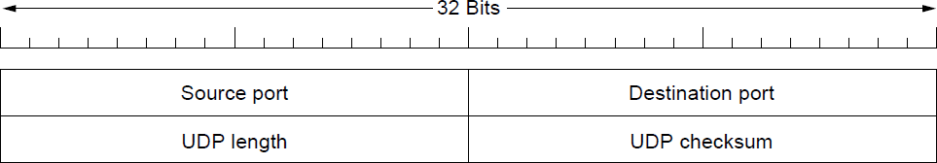
Introduction to UDP
The UDP header.

Slide 7
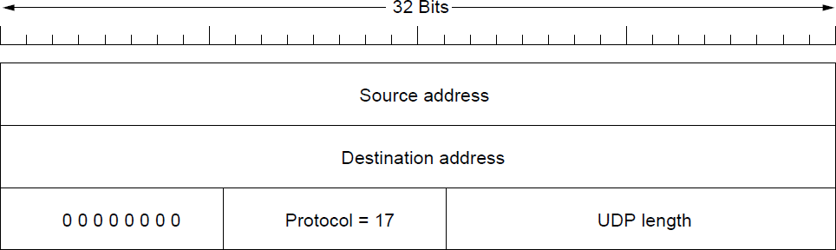
Introduction to UDP
The IPv4 pseudoheader included in the UDP
checksum.

Slide 8
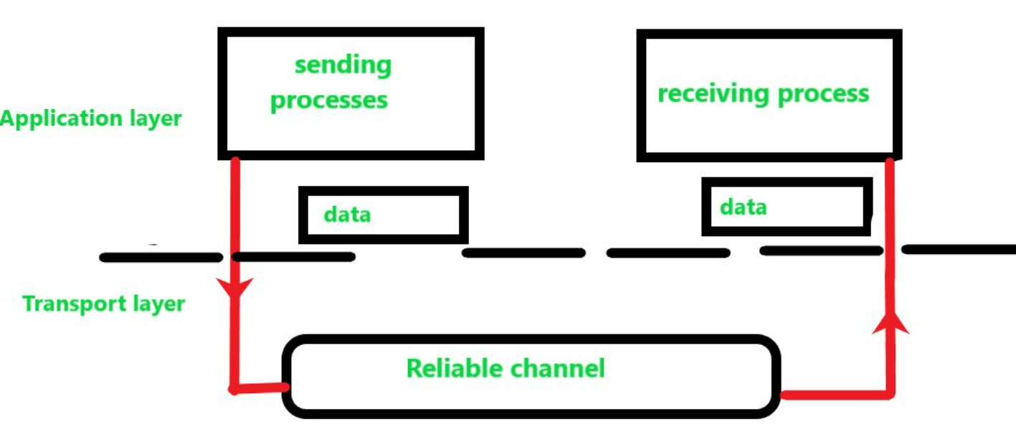
Principles of Reliable Data Transfer:
The problem of transferring the data occurs not only at the transport layer, but also at the application layer as well as in the link layer. This problem occur when a reliable service runs on an unreliable service, For example, TCP (Transmission Control Protocol) is a reliable data transfer protocol that is implemented on top of an unreliable layer, i.e., Internet Protocol (IP) is an end to end network layer protocol.

Slide 9
References
https://en.wikipedia.org/wiki/Leaky_bucket
https://www.geeksforgeeks.org/leaky-bucket-algorithm/
https://en.wikipedia.org/wiki/Token_bucket
https://www.ques10.com/p/31441/what-is-traffic-shaping-explain-leaky-bucket-algor/

Slide 10
THANK YOU
For queries
Email: monica.e9836@cumail.in

